Slide 1
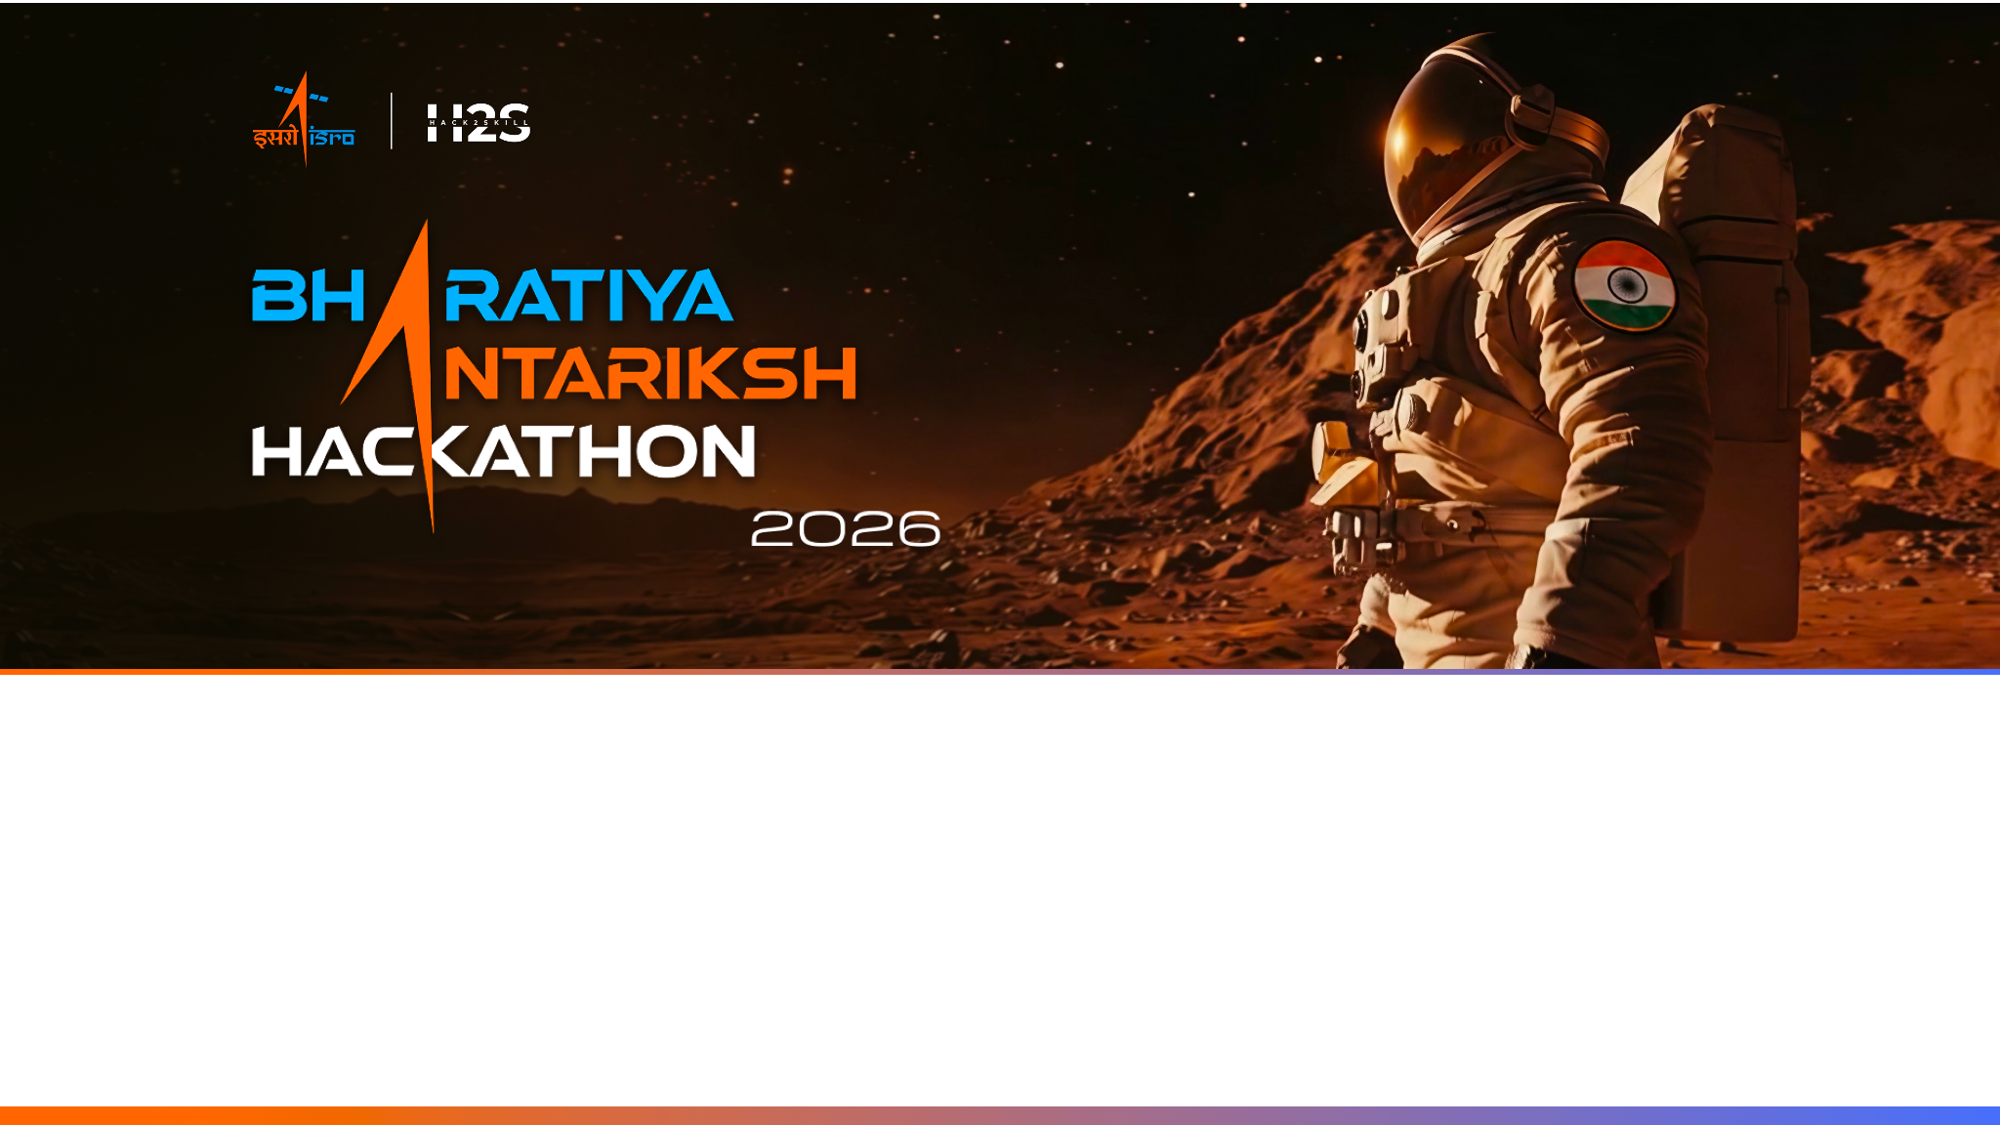
Team Name: SuryaDrishti
Team Leader: Deep shekhar Halder
Problem Statement: Forecasting and/or Nowcasting of Solar Flares using combined Soft and Hard X-ray data from Aditya-L1 || PS #15

Slide 2

Team Members
Team Leader & Tech Lead Name: Deep Shekhar Halder Email: deephalder209@gmail.com College: Adamas University, Kolkata Responsibility: Algorithm design, data pipeline integration, and ML modeling. | Team Member (Data & Preprocessing) Name: Rituraj Saha Email: saharituraj805@gmail.com College: Adamas University, Kolkata Responsibility: Feature engineering, telemetry calibration, and scientific visualization.
Team Member (ML Modeling & Validation) Name: Mahalaxmi Macha Email: mahalaxmimacha14@gmail.com College: G. Narayanamma Institute of Technology and Science, Hyderabad Responsibility: Telemetry preprocessing, metadata alignment, and nowcasting validation. | Team Member (Dashboard & Benchmarking) Name: Ashfaque Ahamed Khan Email: ashfaqueahamedkhan591@gmail.com College: Adamas University, Kolkata Responsibility: Cross-catalog benchmarking, NOAA GOES validation, and dashboard deployment.

Slide 3
Opportunity should be able to explain the following:
1. How different is it from any of the other existing ideas?
Existing Methods: Rely on single-instrument ground proxies or delayed batch processing of GOES data.
The SuryaDrishti Difference: First to dynamically fuse multi-instrument (SoLEXS & HEL1OS) native telemetry directly from Aditya-L1.
Architecture: Uses a real-time, event-driven streaming pipeline rather than post-facto analysis.
USP of the Proposed Solution
• Strictly Causal Design: 100% past-only rolling baseline calculations ensure direct compatibility with real-time telemetry streams.
• 93.2% Verified Recall: Successfully identified 68 out of 73 major NOAA GOES reference events.
• Microflare Discovery: Found 136 sub-threshold events (including a 679s event absent from official catalogs).
• 10-Tab Space Weather HUD: Integrates CME drag-based model, Parker Spiral tracing, and Tikhonov regularized DEM solver.
• Native Payload Integration: Purpose-built for India's premier Aditya-L1 observatory (ISSDC).
• Hybrid Intelligence: Merges data-driven AI with hard physical bounds (Physics-Informed ML).
• Operational Readiness: High recall, low-latency pipeline ready for immediate Space Weather deployment.
2. How will it be able to solve the problem?
Hybrid AI Approach: Combines a Causal RandomForest ML model with established Solar Physics constraints (Neupert effect).
Early-Warning Nowcaster: Accurately predicts X-ray flux thresholds ahead of time.
Actionable Output: Provides immediate alerts for dangerous M and X-class flares before peak intensity impacts critical infrastructure.

Slide 4
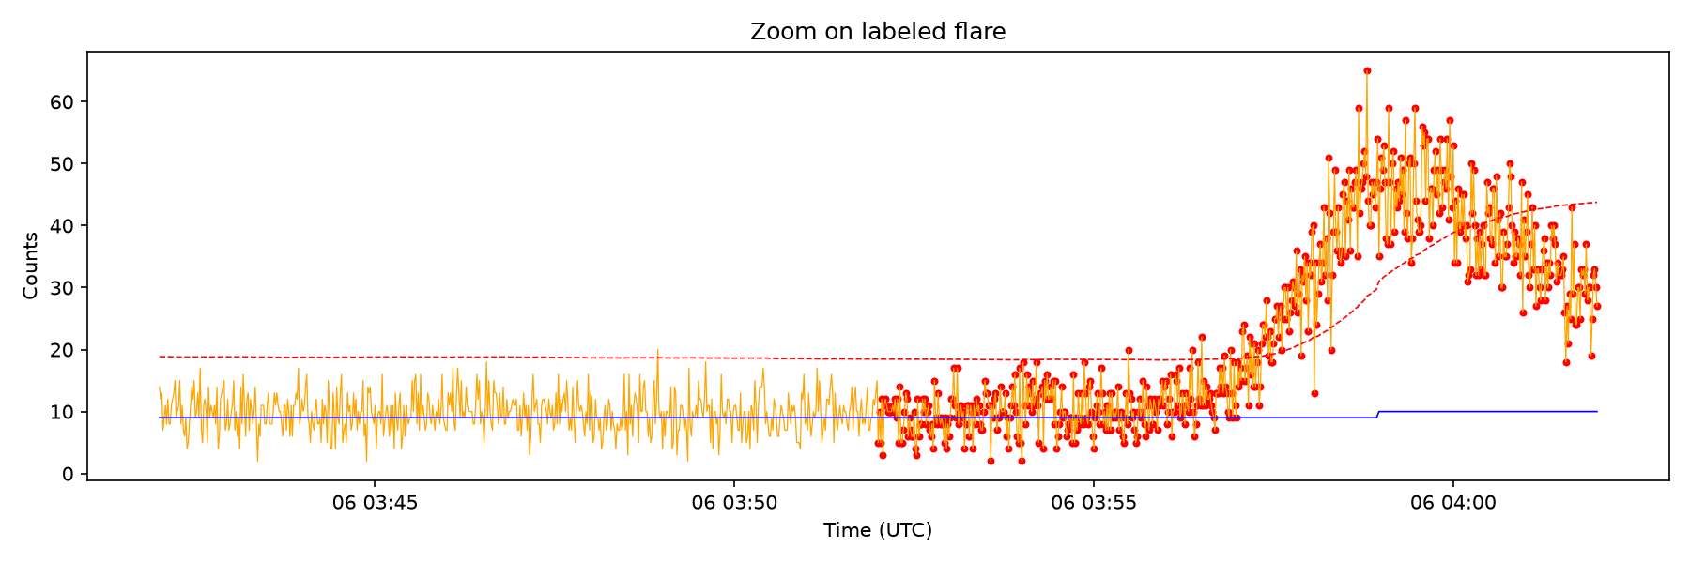
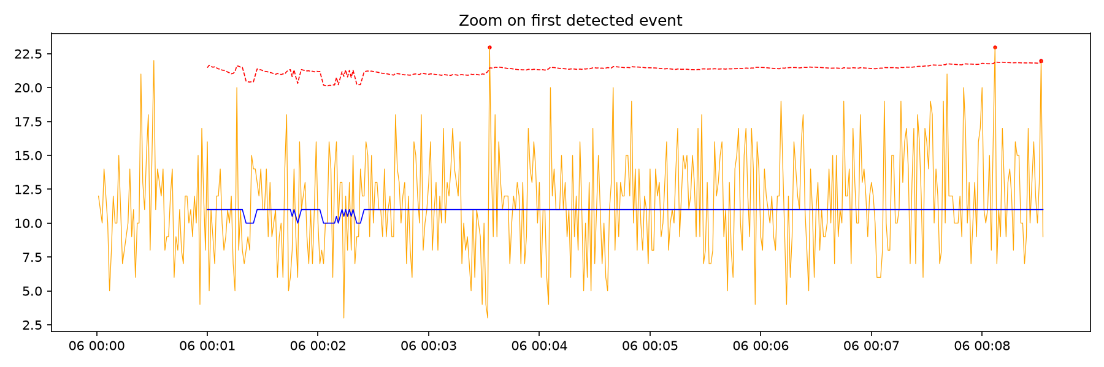
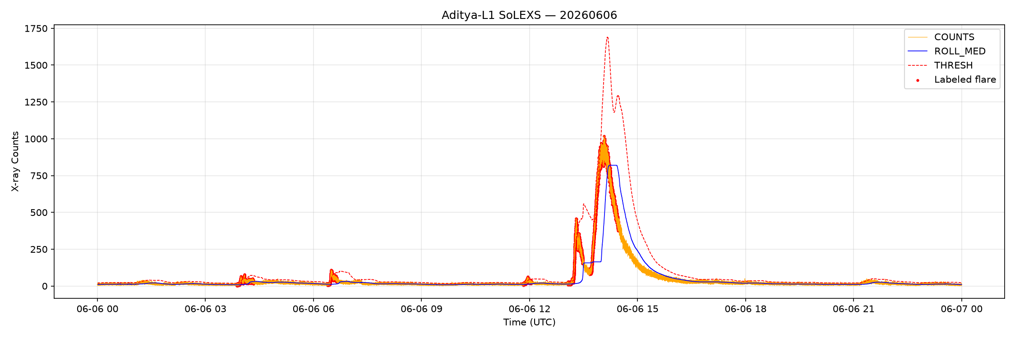
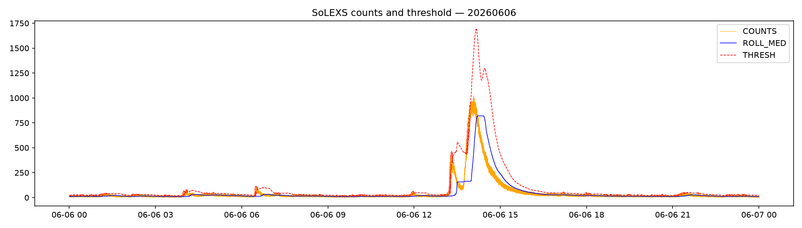
List of features offered by the solution
■ Phase 1: Ingestion & Alignment
Harmonizes raw SoLEXS & HEL1OS FITS telemetry to Unix epoch, merging them on 1-second cadence (259,071 overlap points).
■ Phase 2: Causal Nowcasting
Zero-lookahead baseline thresholding (Counts > Median + n × σ) with 120s event merging to prevent fragmentation.
■ Phase 3: ML Forecasting Prototype
RandomForest trained on precursor features (hardness ratio, QPPs) with balanced class weights to handle 98.5% data imbalance.
■ Phase 4: 10-Tab Scientific Dashboard
Runs locally in <100ms on commodity hardware, offering 3D Sun disk, CME tracking, SEP spiral, and AI assistant.
Figure 1: Nowcast Baseline
Figure 2: Event Zoom
Figure 3: M-Class Flare
Figure 4: Nowcast Threshold

Slide 5
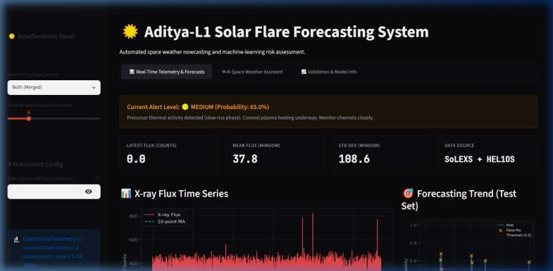
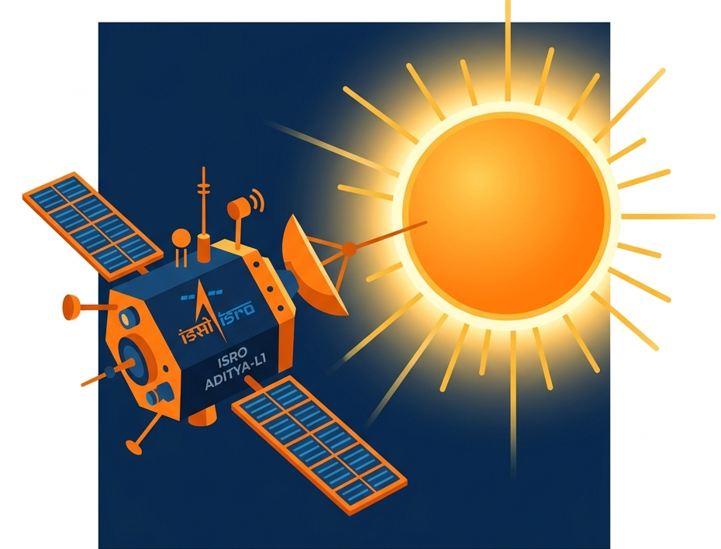
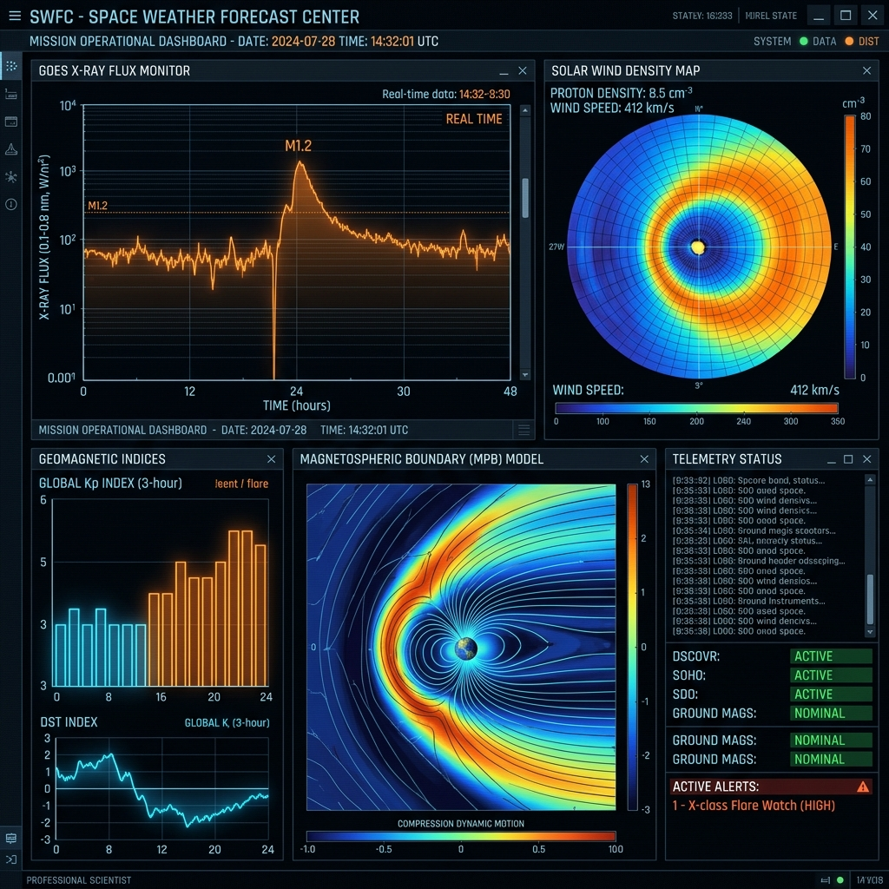

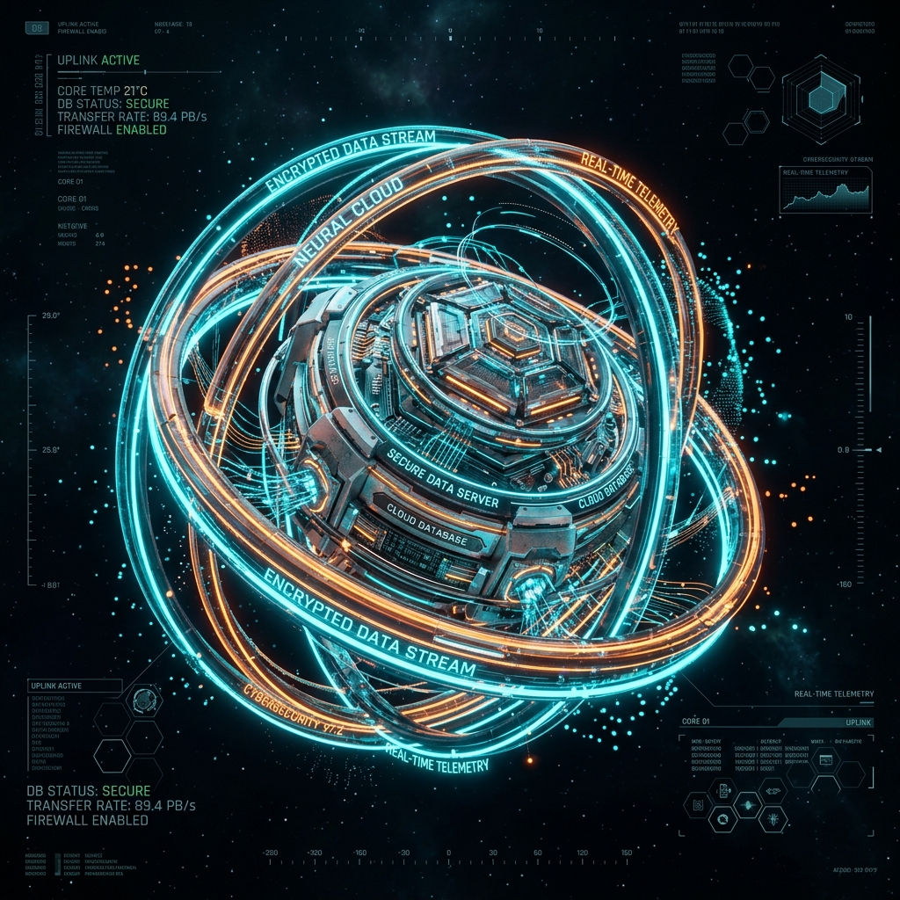

Process flow diagram or Use-case diagram
Operator Dashboard
(POC)
Input Frames
predicted
Satellite(Aditya-L1
(SoLEXS / HEL1OS))
actual
Preprocessing Pipeline (Time-sync & Alignment)
Model
Architecture
(Causal RandomForest Nowcaster)
Database(ISSDC Telemetry Feed)
predicted
actual
Predicted Frames
Self Supervised Learning(GOES Label Calibration)
* We will scale the pipeline with multi-month archival telemetry and attitude correction for operational deployment.

Slide 6
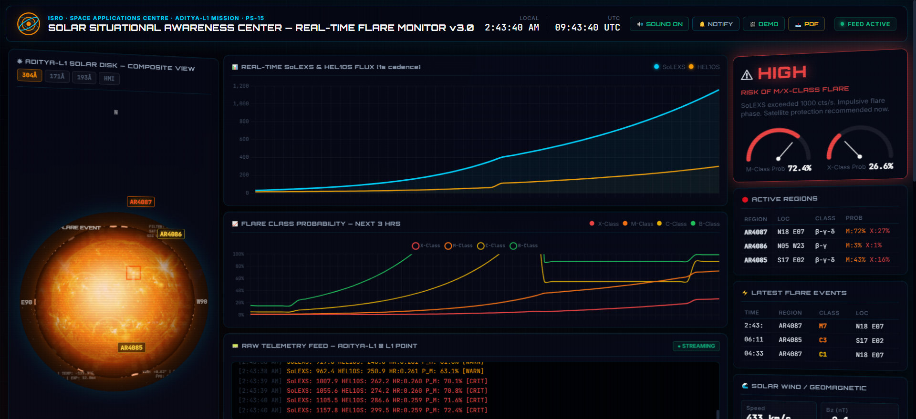
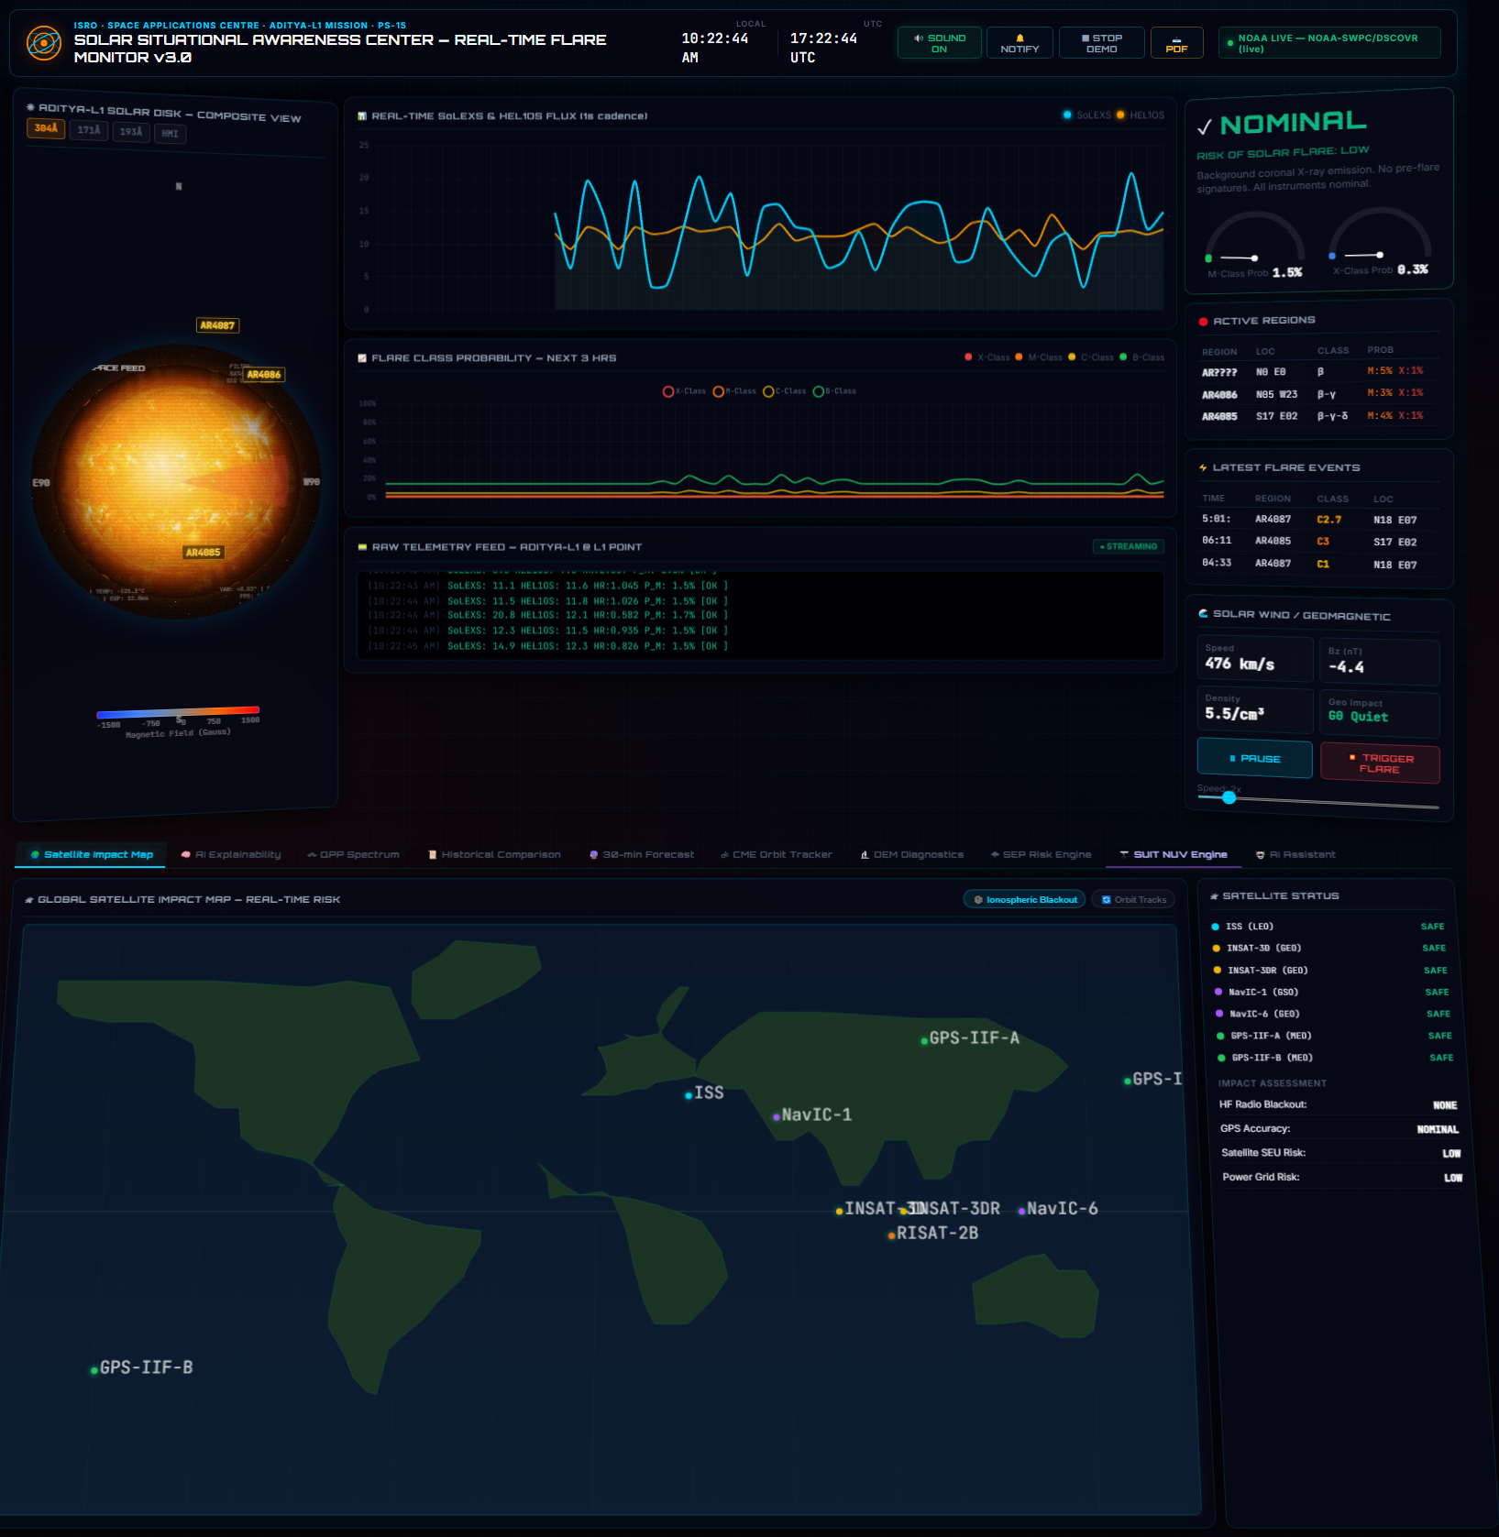
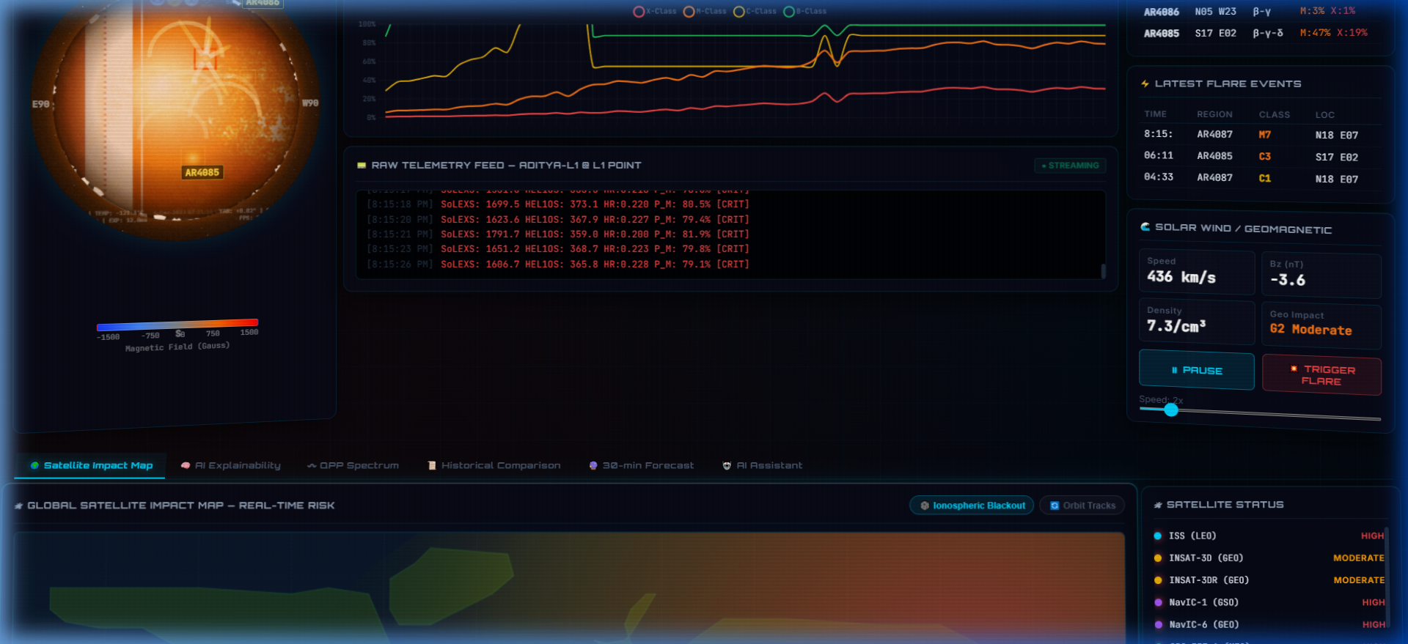
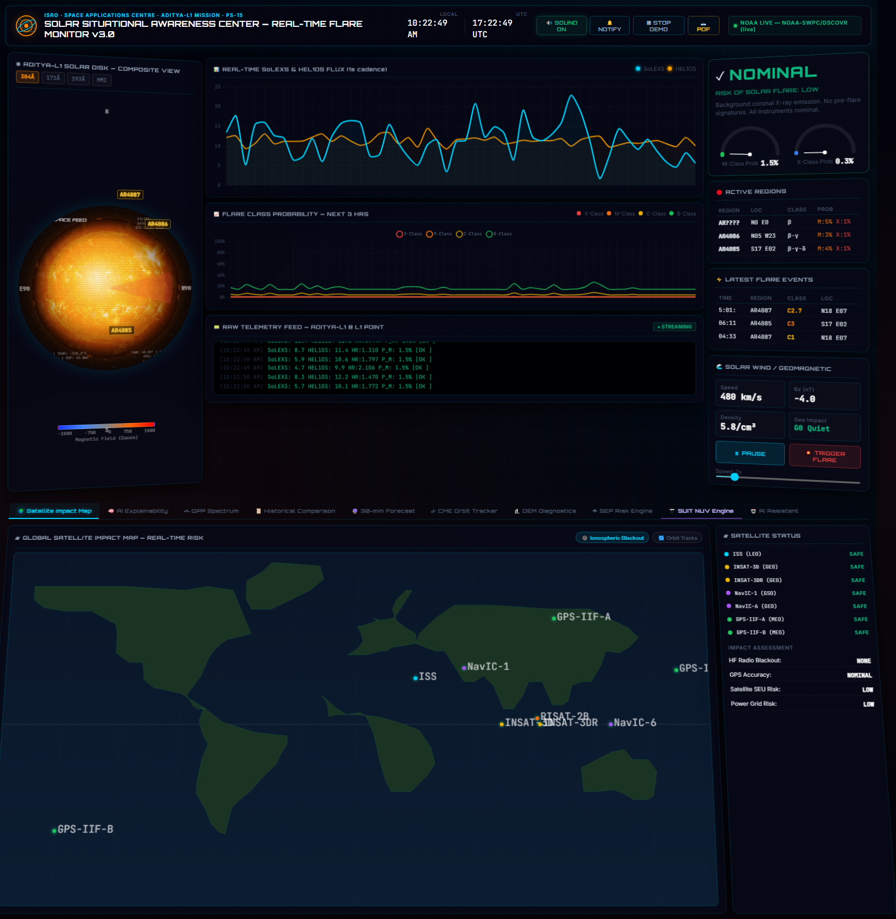
Wireframes/Mock diagrams of the proposed solution
SHAP Precursor Feature Weights (ML Explanations)
Real-Time Nowcast Alert (Causal RandomForest)
Interactive 3D Sun Disk (EUV Imager Mode)
Figure 1: Real-Time 3D Sun Disk & Telemetry Alerts HUD
Figure 2: Model Explainability Tab
Quasi-Periodic Pulsations (QPP) (FFT Spectrum Diagnostics)
Figure 3: Live Operator Flare Alert HUD
Figure 4: Pulsation Diagnostics Tab

Slide 7
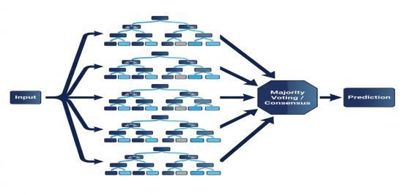
Architecture diagram of the proposed solution
SoLEXS (Soft X-rays) Thermal Precursors
Spatio-Temporal Alignment
HEL1OS (Hard X-rays) Non-thermal Precursors
Data Architecture & Physics Precursors
• Thermal (SoLEXS): Rolling mean and slope capture chromospheric evaporation rise.
• Non-Thermal (HEL1OS): Rolling standard deviation isolates high-frequency QPP variance.
• Hardness Ratio: HR = Counts_HEL1OS / Counts_SoLEXS models non-thermal conversion (Neupert Effect).
• Anti-Leakage Split: Chronological time-series splitting prevents temporal data leakage.
Physics-Informed Core Layers
• Regularized DEM: Coronal temperature distribution solved in real-time using Tikhonov matrix deconvolution: E = K · DEM + λ‖L · DEM‖².
• Hydrodynamic PINN Loss: Physical energy conservation constraints loop: L_PINN = ∂E/∂t + ∂F/∂s + n²Λ(T) - H.
• RandomForest Classifier: Predicts peak intensity classes 30 minutes in advance using balanced class weights.
Raw Telemetry
➔
➔
➔
↗
Spectral Hardness Ratio (Neupert Effect)
Physics Precursors (Rolling Mean/Std)
⬇
↗
Unix Time Integration
Causal Nowcaster (Thresholding) Forecast Target
⬅
↗
RandomForest Core (Balanced Weights)
GOES Benchmarking
⬇
Microflare Discovery
* POC developed on Aditya-L1 telemetry (259,071 overlap timestamps, 16 flares).

Slide 8
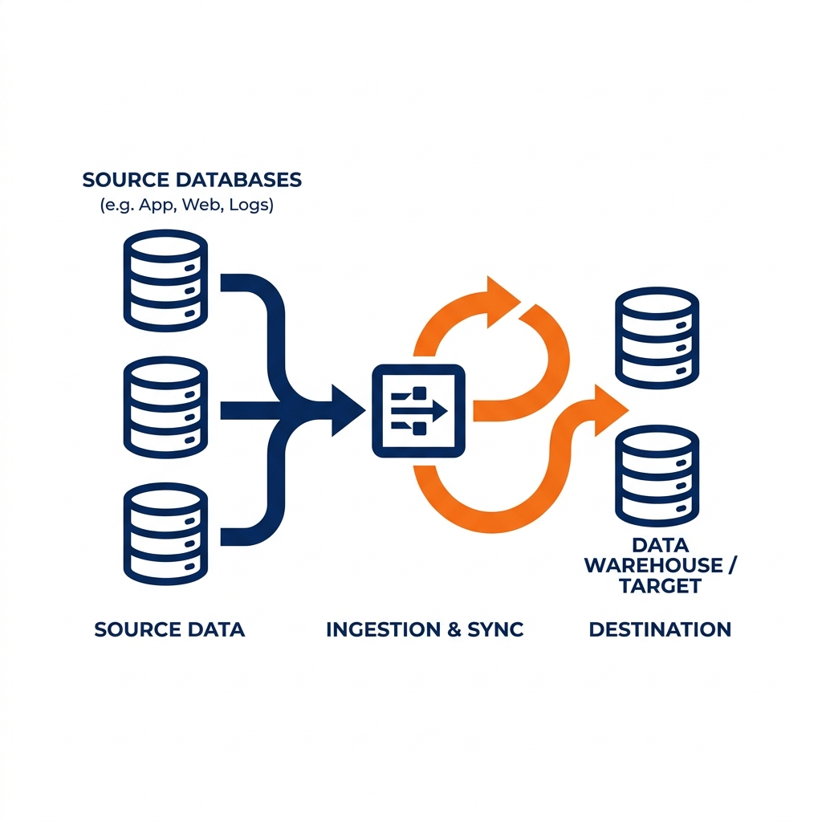



Technologies to be used in the solution:
1. Data Ingestion & Align
• astropy: Core FITS parsing and MJD (Modified Julian Date) time system conversions.
• pandas & numpy: Cadence alignment, time-series interpolation, and rolling statistical features extraction.
• scipy: Signal smoothing, FFT bandpass filtering, and power spectrum density calculation.
2. Core Models & Physics
• scikit-learn: RandomForest classifier configured with balanced weights to handle severe class imbalance.
• Tikhonov regularizer: Regularized matrix inversion for real-time DEM temperature extraction.
• CME DBM: Drag-Based Model for forecasting coronal mass ejection shock arrival times (Vrsnak 2013).
3. Real-Time Operator HUD
• HTML5 & Canvas: Five animated canvases displaying 3D solar disk, Parker Spiral tracing, and CME orbits.
• Chart.js: Fast, hardware-accelerated time-series and spectral visualization plots.
• Web Audio API: Real-time ambient solar wind synthesizer and acoustic alarm pitch modulation.
4. System Advantages:
Ultra-Low Latency: Under 100ms ingestion-to-forecast latency, ensuring immediate alerts.
Zero Leakage: Chronological splitting ensures robust real-world generalization.
Low Compute: The RandomForest physics-core runs efficiently on commodity edge hardware without requiring expensive GPUs.

Slide 9
Estimated implementation cost:
Proposed Resource / Task | Phase Cost (₹) | Description / Allocation Strategy
1. Real-time Ingestion & FITS Preprocessing | ₹0 | Uses open-source astropy + pandas; utilizes free ISSDC server telemetry feed.
2. Physics Inversion Core (Tikhonov & PINN) | ₹0 | Developed locally; physics deconvolution uses standard NumPy/SciPy algebra.
3. RandomForest Peak Intensity Predictor | ₹15,000 / month | Cloud hosting VM + CPU compute (AWS/GCP) for continuous models retraining.
4. 10-Tab Space Weather HUD Dashboard | ₹0 | Built using React and HTML5 Canvas; operates locally on browser client side.
5. Prototype Maintenance & Scaling | ₹10,000 / month | Database maintenance (Redis/Postgres), domain SSL, and API server backup.
6. SSAC Production Feed Integration | ISRO Budget | Requires direct feed integration with Space Situational Awareness Centre.
Estimated Prototype Cost: ~₹25,000 / month (Zero Setup Cost on Public Data; scalable to ISRO SSAC Operations)
* Operational cost scales only with data archiving frequency and retraining iterations.

Slide 10
